Slide 1

Food Detectives Inc.
Brian Colantonio
Michael Day
Dercio Torres
Notes:
NOTE: To change images on this slide, select a picture and delete it. Then click the Insert Picture icon
in the placeholder to insert your own image.

Slide 2

An application to meet the need of our unique diets.
YOUR TIME IS VALUABLE!
Reclaim the time you spend studying long lists of hard-to-pronounce ingredients.
Notes:
NOTE: To change images on this slide, select a picture and delete it. Then click the Insert Picture icon
in the placeholder to insert your own image.

Slide 3
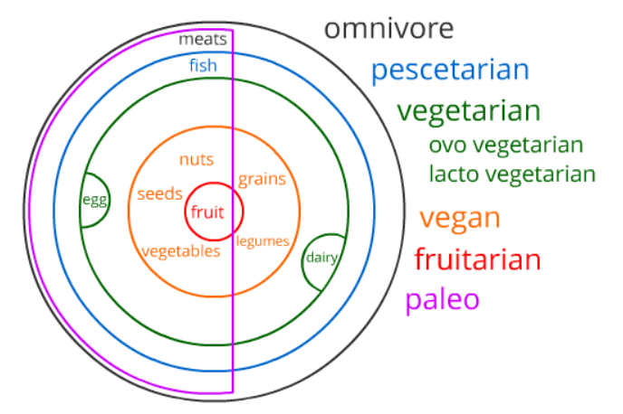
We are working to include functionality for everybody.

Slide 4
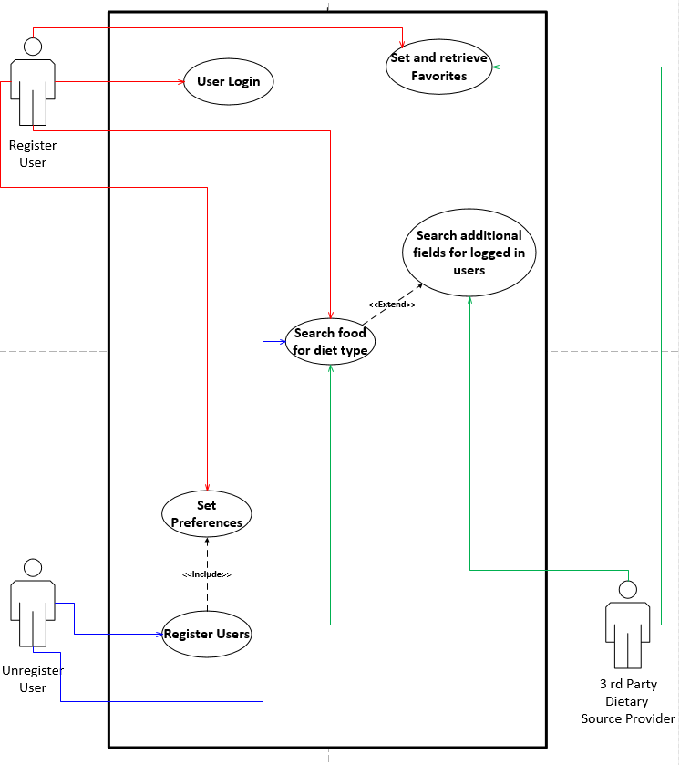
Use Cases:
*Unregistered Users
*Registered Users
*3rd Party Dietary Source Provider

Slide 5
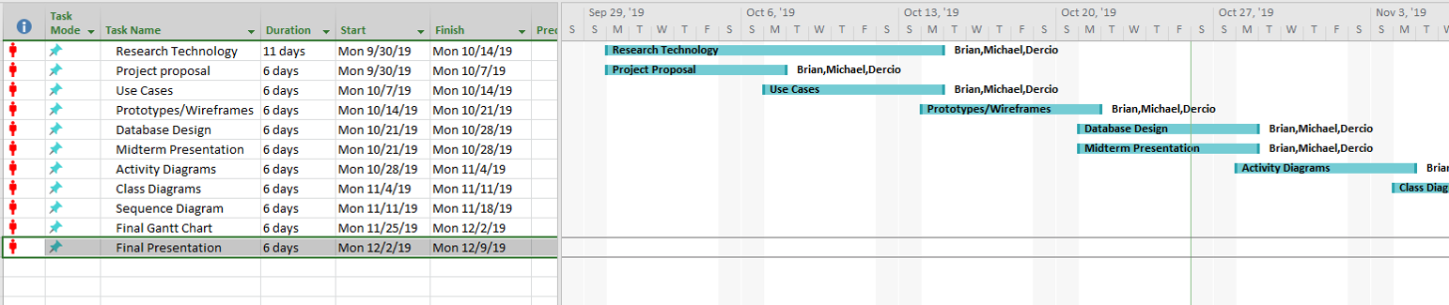
Project design Process Flow

Slide 6
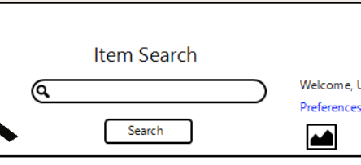
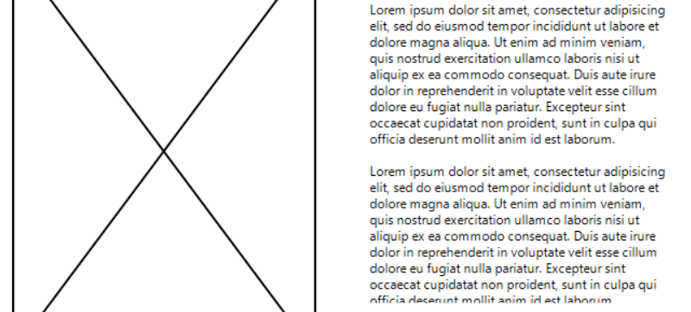
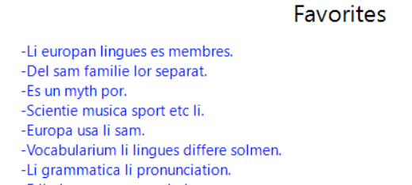
Practical access through your device’s browser--
Basic functionality available to everyone.
Advanced features offered to registered users of a free account.

Slide 7




Technology
Notes:
NOTE: To change images on this slide, select a picture and delete it. Then click the Insert Picture icon
in the placeholder to insert your own image.

Slide 8
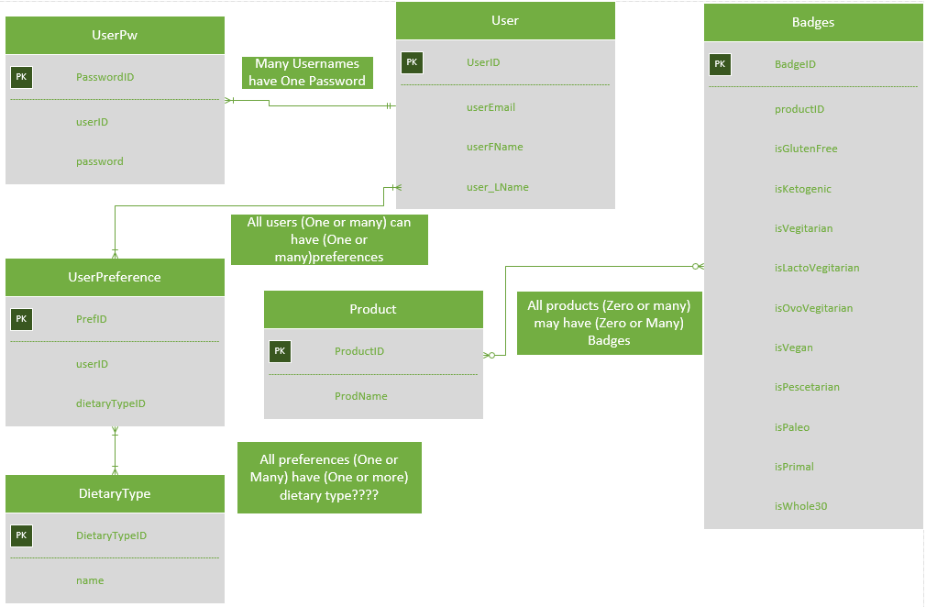
Database Structure:
*Users
*Preferences
*Badges

